Slide 1
Visual
Data
Presentation
Part I
© McGraw Hill LLC. All rights reserved. No reproduction or distribution without the prior written consent of McGraw Hill LLC.

Slide 2
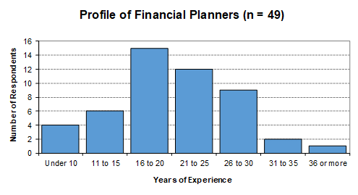
Tables vs. Graphs
Tables are clear and precise.
But graphs have more impact.
Table
Graph

Slide 3
Basic Principles
Learn the types of graphs and when they are appropriate.
Learn and apply the rules of good graphing. It takes practice – like golf.
Avoid visual tricks and deceptions that may confuse others.
Think critically. Does your graph show the data effectively? Ask your co-workers.

Slide 4

Complexity
Keep It simple. Why make the reader hard to see the main point?
Focus on your main objective. Omit unnecessary details or “bonus” data that can be plotted on the same axes.
10 Second Rule A display fails unless it conveys its main message within ten seconds.

Slide 5
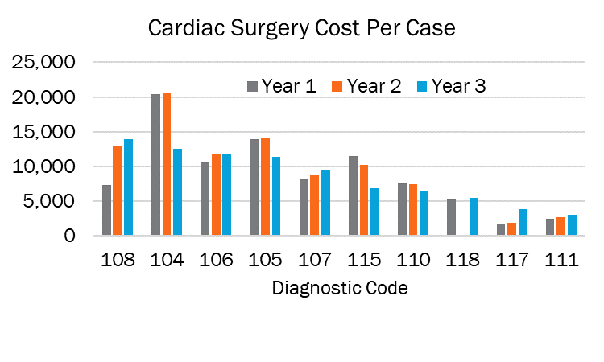
Table or Graph?
A graph is not always clearer than a table.
Hard to interpret?
But is the chart any better?

Slide 6
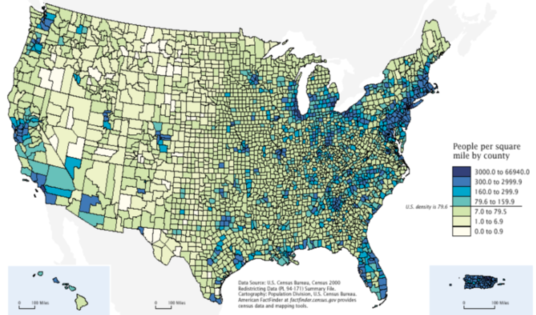
Maps
Maps are powerful data displays.

Slide 7
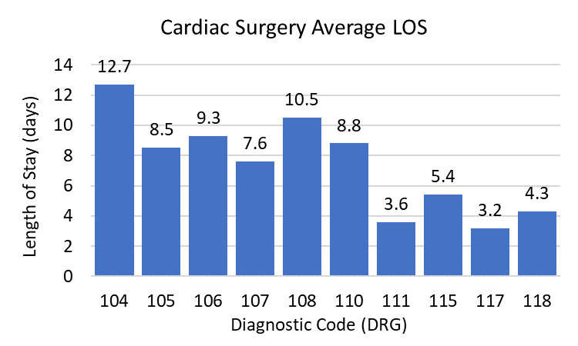
Column Chart
The most familiar type of chart in business.

Slide 8
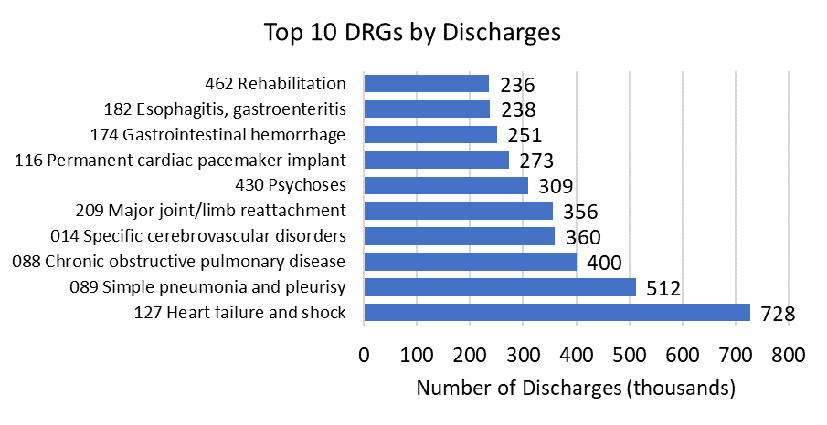
Bar Chart
Long axis labels may look better on a bar chart than on a column chart.

Slide 9
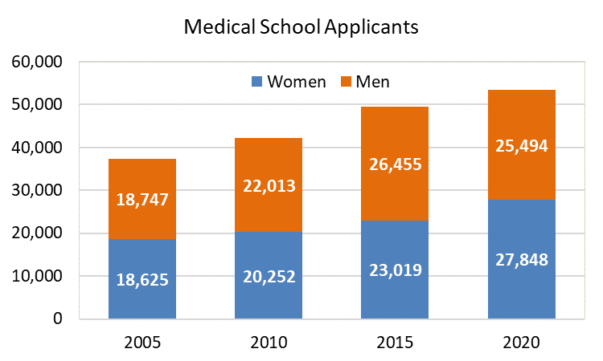
Stacked Column Chart
Labeling data values adds the clarity of a table to the visual impact of a chart.

Slide 10
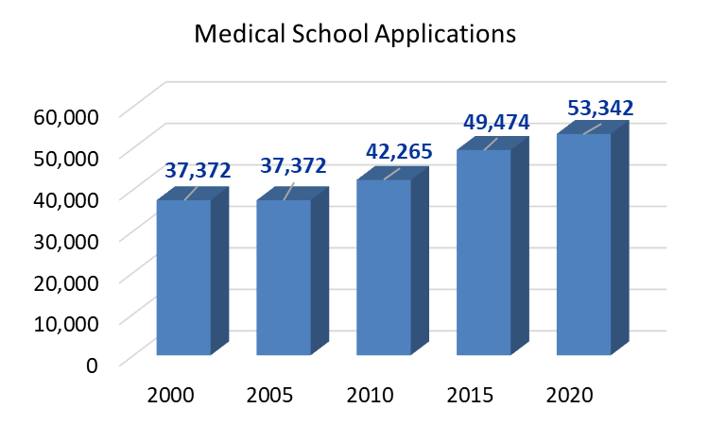
3D Column Chart
Visually interesting, but bar height is ambiguous. Which “bar edge” (front or back) should you read?
Data labels are helpful.

Slide 11
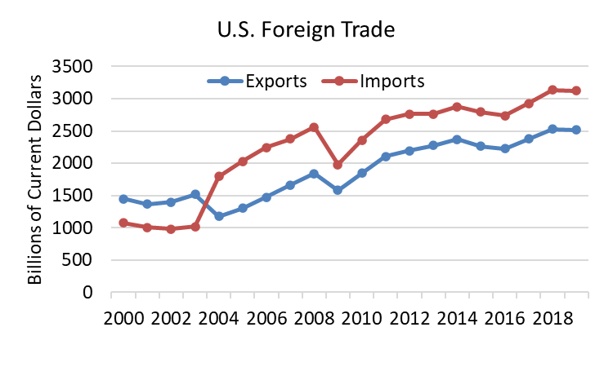
Line Graph
If more than 2 or 3 variables are plotted at once, a line chart may become cluttered.

Slide 12
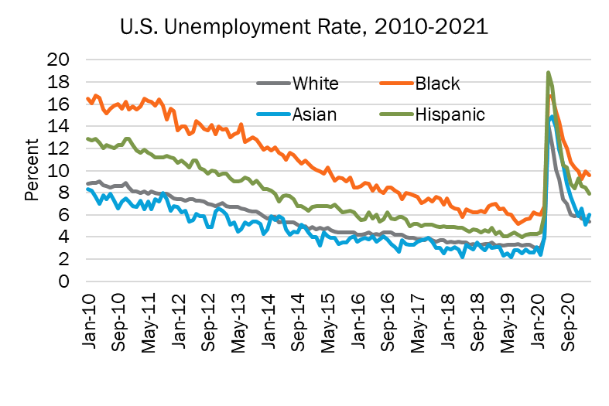
Line Markers
Thick plot lines make it easier to see trends, but harder to see data values.
A plain line graph without markers is best for multiple time series variables.

Slide 13
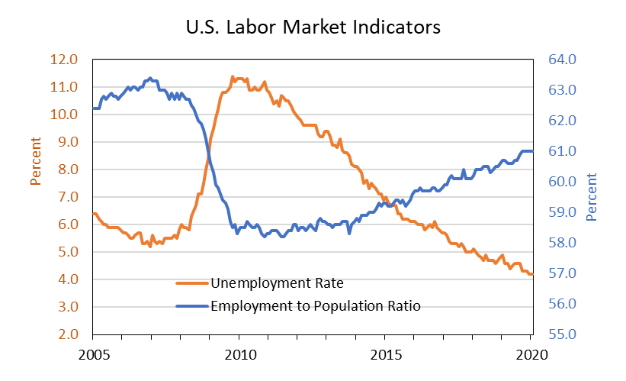
Dual Scale
A dual-scale chart is useful to plot two time series with dissimilar magnitudes.

Slide 14
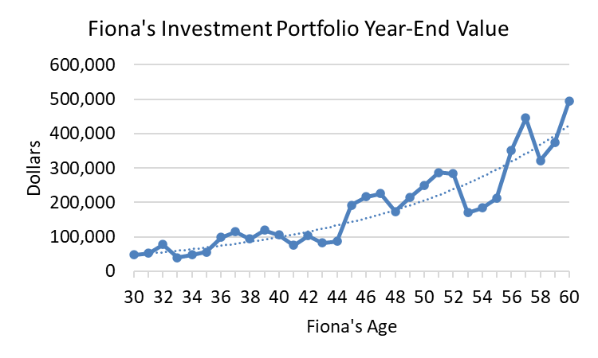
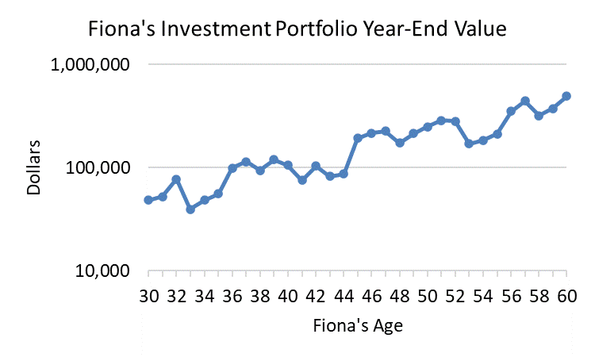

Log Scale
Over 30 years, Fiona's portfolio grew non-linearly (7.2% annual average).
On a log scale a series growing at a constant percent rate appears as a straight line.
Tip: Many people do not understand log scales. Be prepared to interpret.

Slide 15
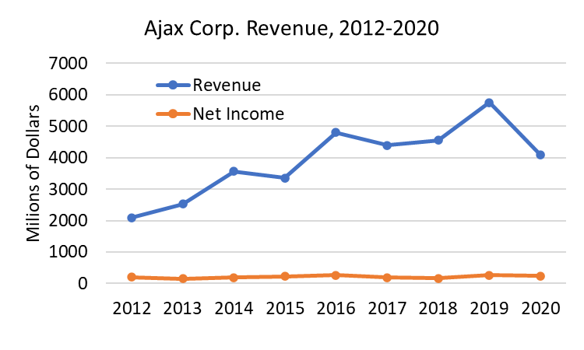
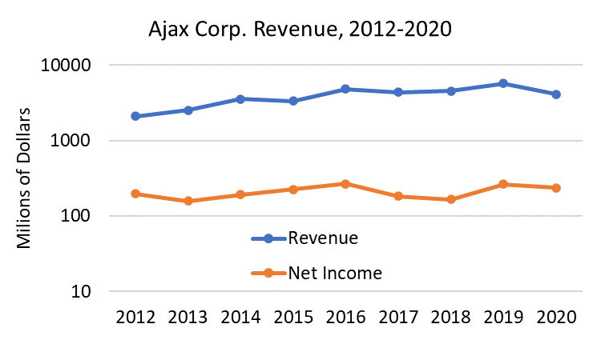
Log Scale
Did net income grow more slowly than revenue? Differing data magnitudes make it impossible to tell.
A log scale can help compare growth rates in two time series of dissimilar magnitude.

Slide 16
Log Scale
Differing data magnitudes make it hard to tell which grew faster.
On a log scale we can see that revenue and net income grew at similar rates.

Slide 17
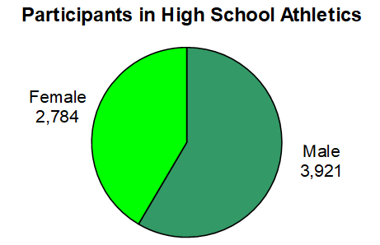
2D Pie Chart
The best pie charts have only 2 or 3 slices.

Slide 18
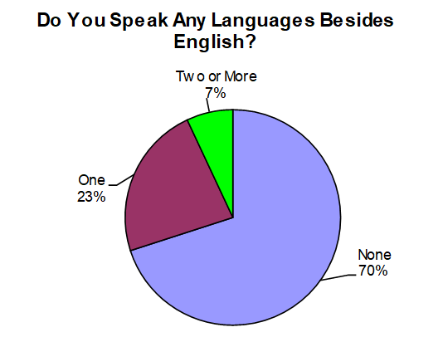
2D Pie Chart
A pie chart is appropriate only when its components are parts of a whole. They must sum to 100%.

Slide 19
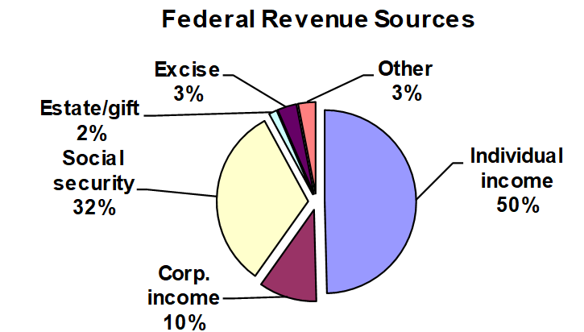
Too Many Slices?
The more slices in the pie, the harder it is to see data values. Value labels are a “must.”

Slide 20
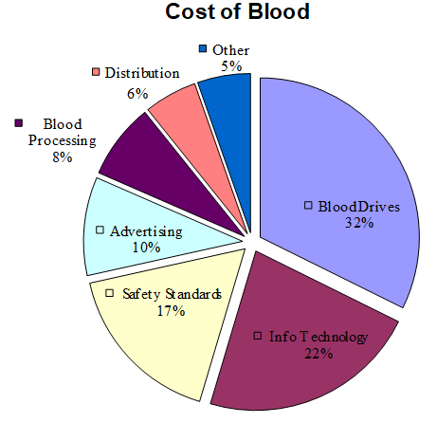
Exploded 2D Pie
Too many "slices"? But data labels are helpful.

Slide 21
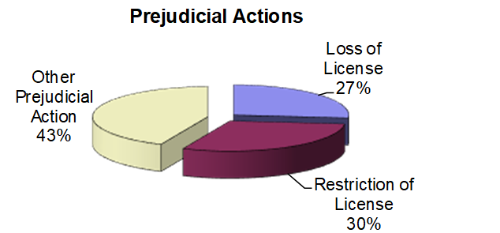
Rotated 3D Pie
Visually appealing, but acceptable only if a few well-labeled data values are presented.

Slide 22
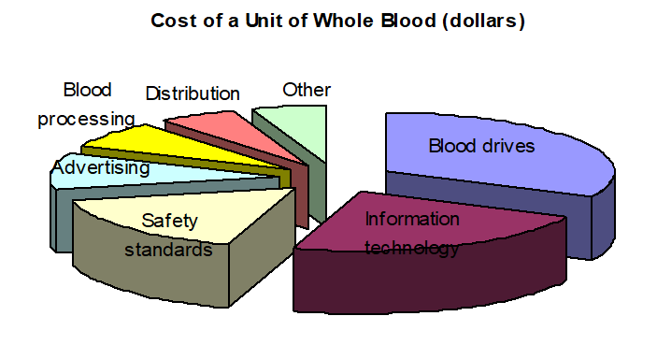
Too Busy?
A pie chart is ineffective if it has too many slices and lacks data labels.

Slide 23
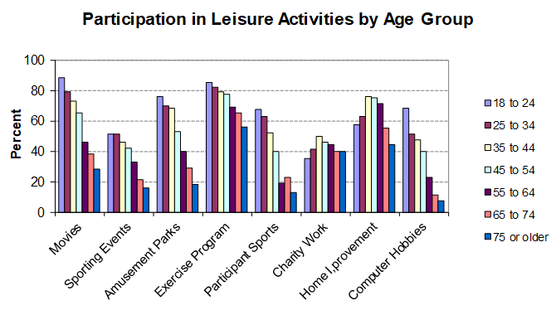
Too Much Information?
A chart is ineffective if it tries to show too much information.

Slide 24
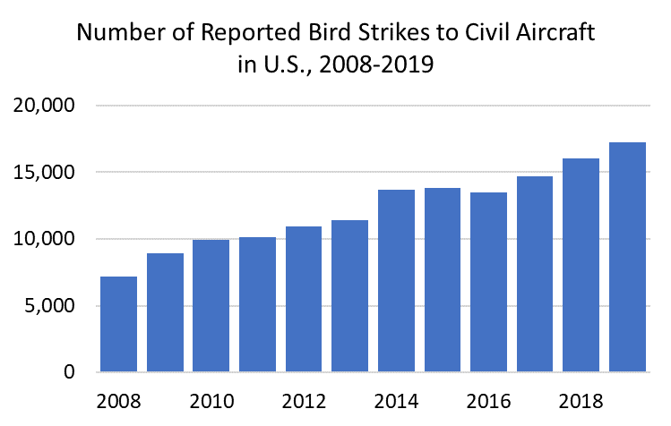
Graph Proportions
4:3 rule (width:height, pre-HDTV).
16:9 (width:height, HDTV).
~ 8:5 (width:height, Excel chart default).
Source: http://wildlife-mitigation.tc.faa.gov.

Slide 25
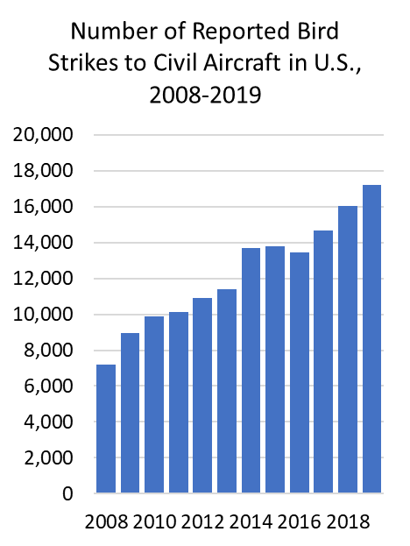
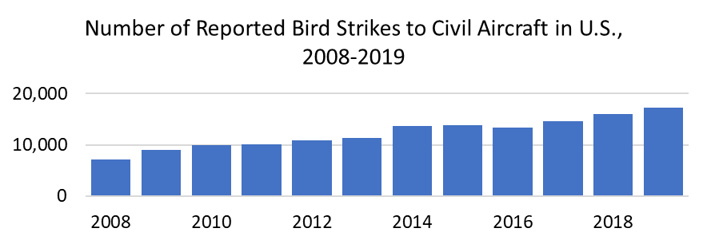
Graph Proportions
Squeezed X scale (emphasizes growth)
Stretched X scale (downplays growth)

Slide 26
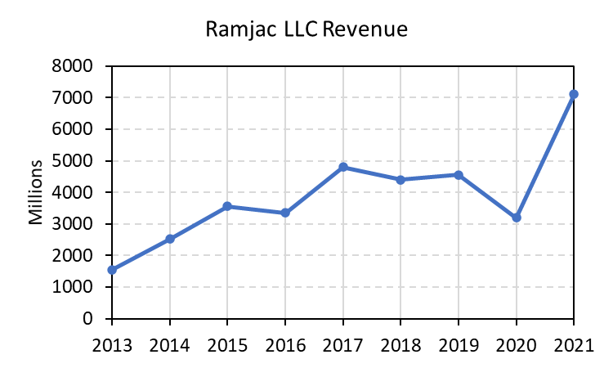
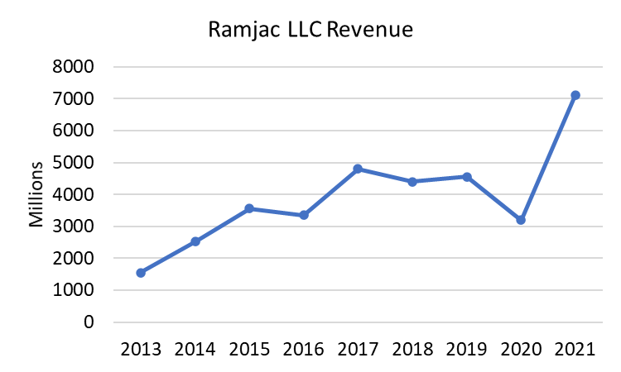
Axis Ticks and Gridlines
Axis "tick” marks help the reader identify individual data values.
Excel allows solid, dotted, and colored grid to suit your purpose.
Gridlines may be omitted if graph is simple and precision is of less importance.

Slide 27
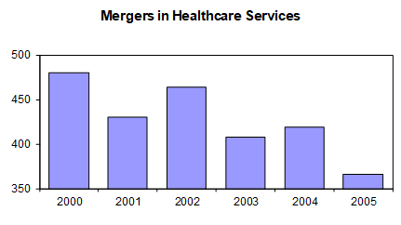
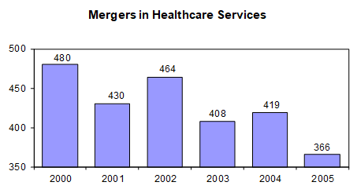
Gridlines
Without gridlines, data values are harder to read.
Insert data labels if you must omit gridlines.
Source: Modern Healthcare, Vol. 29, N.3 4, Aug. 23, 1999, p. 3.

Slide 28
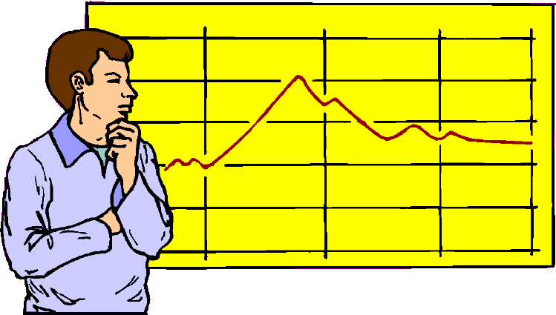
Non-Zero Origin
A non-zero origin on the Y-axis exaggerates taller bars relative to shorter ones.
Measured bar height does not match the stated values or axis demarcations.
Unless there is an axis scale, you will need a ruler to detect this problem.

Slide 29
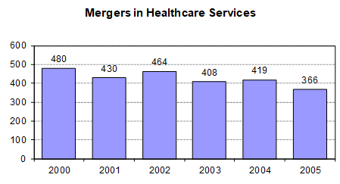
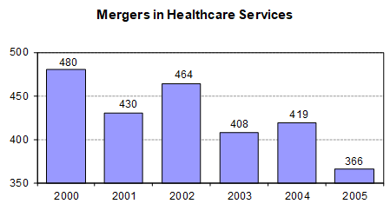
Non-Zero Origin
Zero origin shows correct bar proportions.
Non-zero origin exaggerates the decline.
Source: Modern Healthcare, Vol. 29, N.3 4, Aug. 23, 1999, p. 3.

Slide 30
Not Really a Graph
Some visual displays are just for fun and need not be judged as serious graphs.

Slide 31
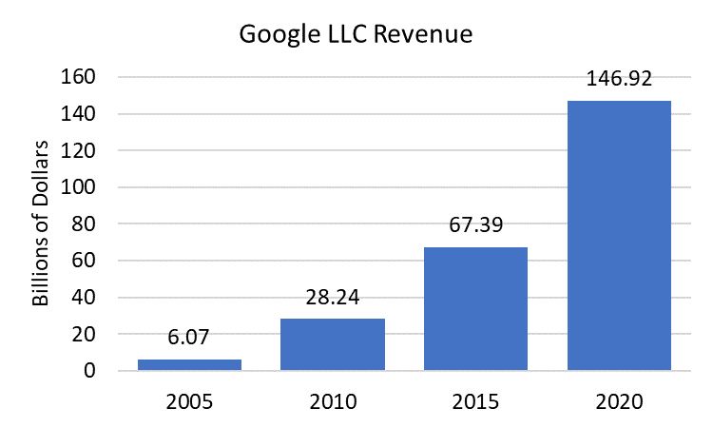
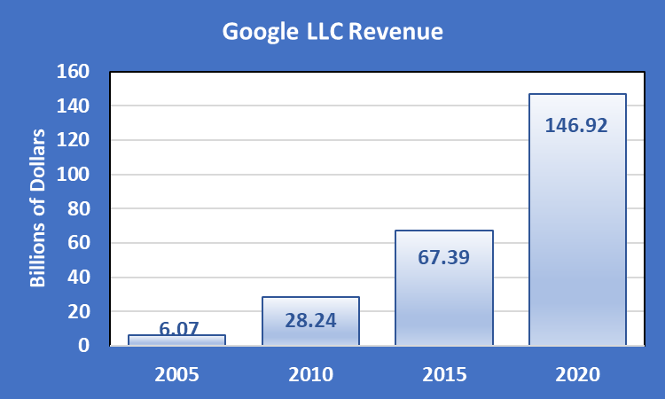
Excel Charts
You can make Excel's default charts more colorful. But is it better? You must decide.
Default
Customized

